Slide 1






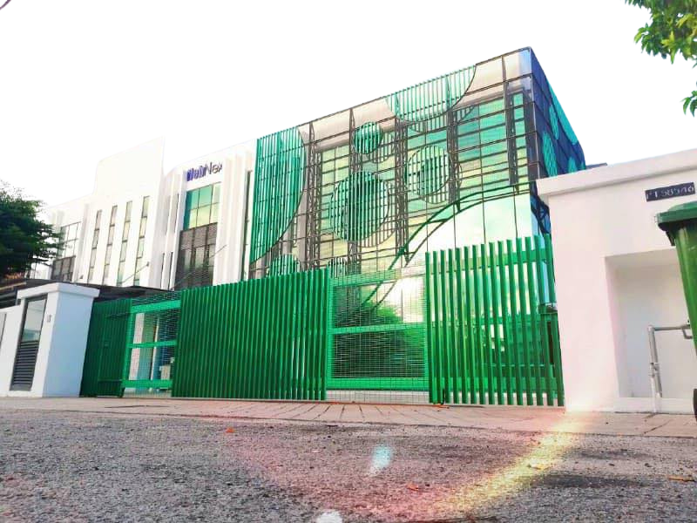
RESEARCH | DEVELOPMENT | CONSULTANCY |
CONTRACT MANUFACTURING

Slide 2


2025
CBS ENTREPRENEUR TEAMS
PROGRAM

Slide 3

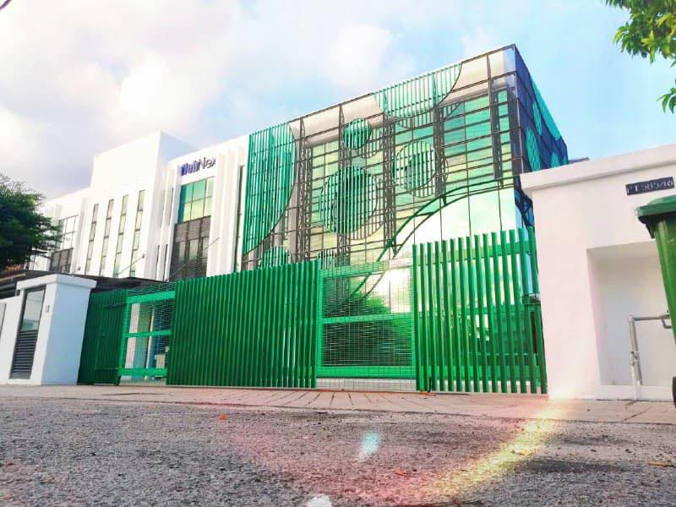
is excited to introduce
, a unique concept designed to inspire a lifestyle of health, wealth, and grace. We warmly welcome our valued VViPs and their VIP guests to an exclusive launch event.
Research
Development
Consultancy
Manufacturing
SLOGANS
ALL THAT WE NEED!!
LET FOOD BE THY MEDICINE!

Slide 4
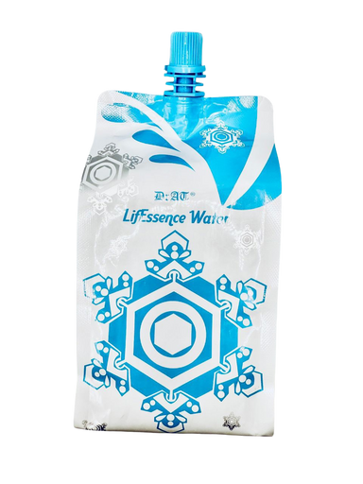
As a token of our appreciation, guests will receive special table gifts and stand a chance to win a one-year supply (365 packs) of DrAT LifEssence Water, valued at RM7,300.
Research
Development
Consultancy
Manufacturing
SLOGANS
ALL THAT WE NEED!!
LET FOOD BE THY MEDICINE!

Slide 5
Join us as we celebrate this momentous occasion and unveil the vision of DrAT—an opportunity for VVIP attendees to partner with NebNex through the DrAT platform as part of our CBS (Consumer, Business, Shareholders) Team. This platform empowers our CBS team to grow and succeed in business alongside Nebnex.
Research
Development
Consultancy
Manufacturing
SLOGANS
ALL THAT WE NEED!!
LET FOOD BE THY MEDICINE!

Slide 6



TRANSFORM YOUR LIFE: EXCLUSIVE OFFER IN
STEPS

Slide 7

Dr.AT
1.
Experience Ultimate Wellness with Our Exclusive Bundle!
Receive a one-year supply of:
  366 bottles of 8ml DrAT HEALL Rub (valued at RM 4,209, T&Cs apply)
  730 packs of 500ml DrAT LifEssence Water (worth RM 14,600, T&Cs apply)
Plus, enjoy curated free gifts for an enhanced wellness experience!

Slide 8

Dr.AT
2
Transformative Investment
Make a one-time Spending for a healthier, wealthier, and graceful living. This Spending benefits you and your loved ones.

Slide 9

Dr.AT
3.
Money-Back Guarantee
Rest assured with our money-back guarantee and 5 million products warranty. Your satisfaction is our priority.

Slide 10

Dr.AT
4.
Act Now
This limited-time offer is available only from July 1st to 15th. Secure your spot before it's too late. Contact us to join!

Slide 11

CBS ENTREPRENEUR PROGRAM:
CONSUMER, BUSINESS, SHAREHOLDER

Slide 12





Discover the CBS Enterpreneur Program!
Our CBS Entrepreneur Program is a unique initiative designed to harmonize the interests of Consumers, Businesses, and Shareholders. By creating a synergistic environment, it ensures:
01
Enhanced Consumer Experience
02
Business Growth and Innovation
Consumer, Business, Shareholder (CBS)
03
Shareholder Value and Returns
Join us in this journey towards sustainable growth and shared success!

Slide 13


TRANS﻿FORM YOUR LIFE:
STEPS ﻿TO BECOME OUR
EXCLUSIVE
TEAM
CBS

Slide 14





















03
04
Ultimate Wellness Experience :
Hydration Boost:
Luxurious Free Gifts:
Enjoy unparalleled rewards:
Supporting the Community:
01
02
05
07
06
10
Drive towards your dreams:
Special credit Treat:
Essential Products Selection:
Monthly Overseas Tours:
Investment Refund and Rewards:
08
09

Slide 15






LUXURIOUS FREE GIFTS:
Indulge in Luxurious free Gifts curated Just for you
Treat Yourself to curated luxury items!

Slide 16
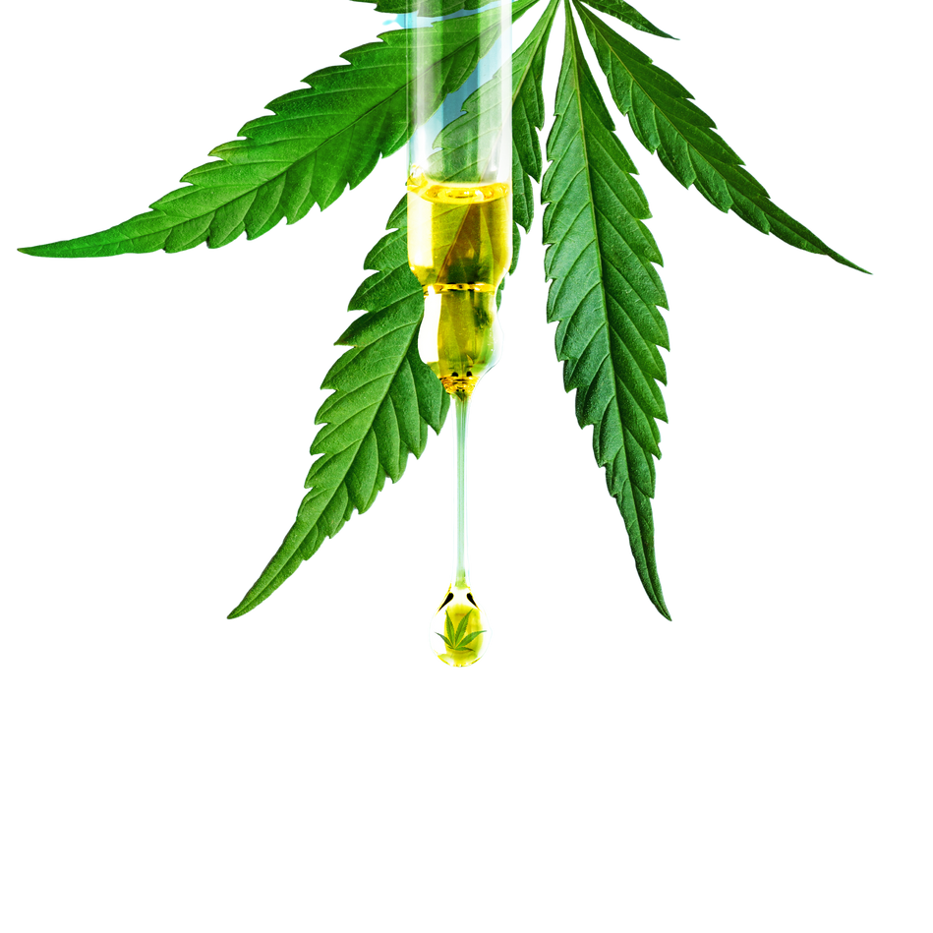


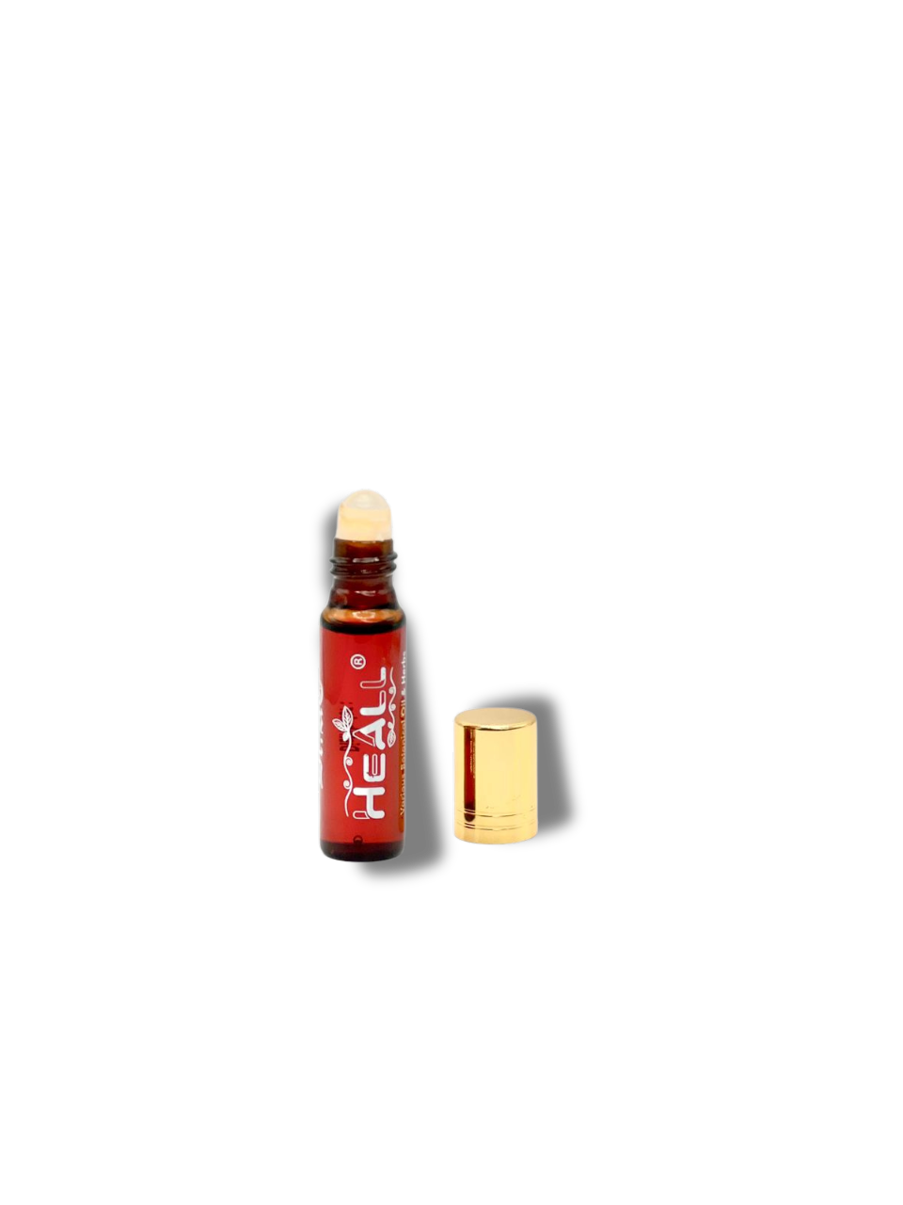
ULTIMATE WELLNESS EXPERIENCE :
A complimentary 366 bottles 8ml DrAT HEALL Rub, valued at an Impressive RM4209.00
Experience the finest ingredients crafted for your well-being.
(Terms & Conditions apply)

Slide 17



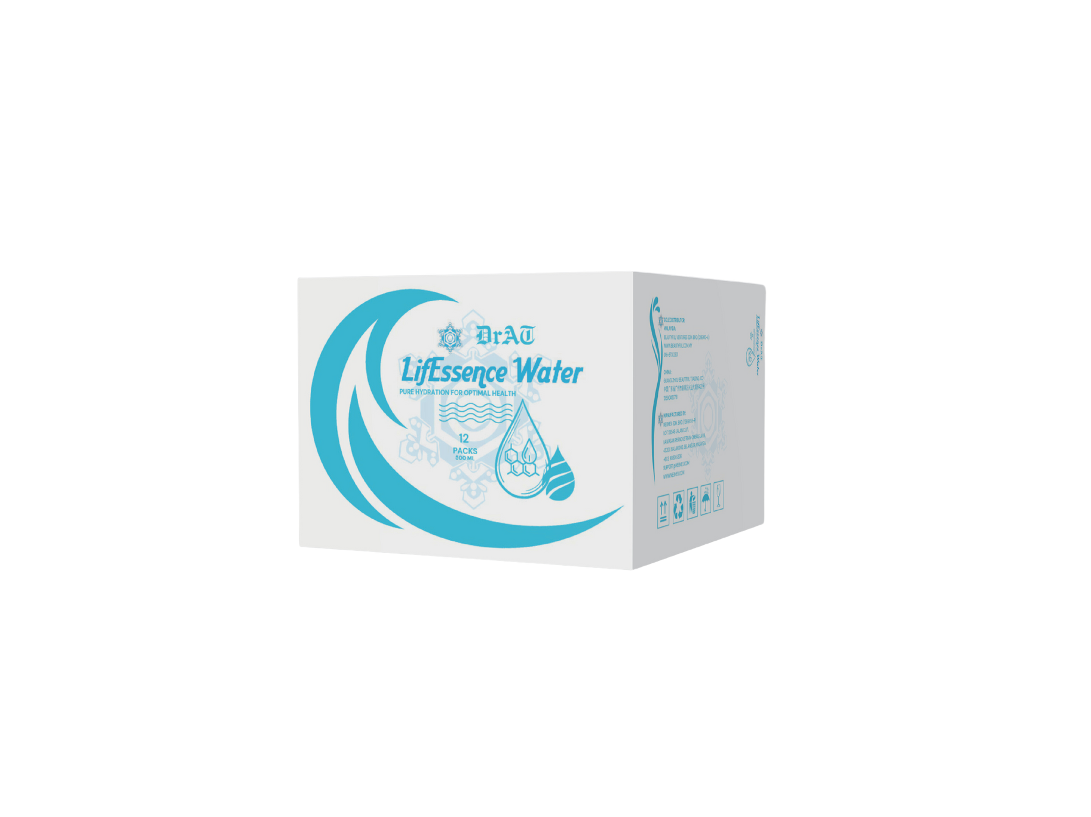


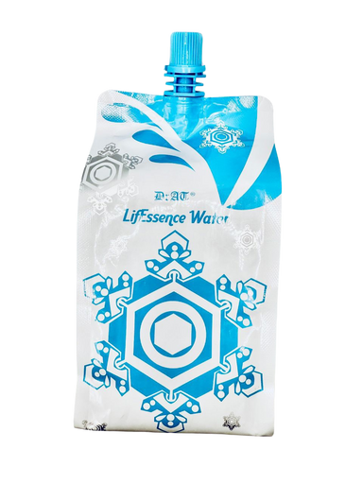
HYDRATION BOOST:
Quench your thirst for Wellness with a Complimentary one-Year supply 730 packs of DrAT LifEssence Water, Valued at RM14600. 00
Stay refreshed and healthy with DrAT LifEssence Water!
(Terms & Conditions apply)

Slide 18




ENJOY UNPARALLELED REWARDS:
ESSENTIALS
influncer
rm2000.00
Valid Until 23 September, 2025
Minimum Spend $50
Valid Until 23 September, 2025
⁠Enjoy paralleled Cashback DIGITAL Credit Rewards.
ESSENTIALS
enchelon
rm10,000.00
Valid Until 23 September, 2025
ESSENTIALS
(Terms & Conditions apply)
supreme
rm20,000.00
Unlock incredible savings and redeem your credit today!
Valid Until 23 September, 2025
ESSENTIALS
imperial
rm30,000.00
Valid Until 23 September, 2025

Slide 19



SUPPORTING THE COMMUNITY:
For all our company proceeds, we allocate 10% to orphanages, SJK schools and folk homes.
Supporting education, shelter, and community well-being.

Slide 20




INVESTMENT REFUND AND REWARDS:
Initial Investment Refund:
Recruit 3 CBS within two months, and you will receive a full refund of your initial investment in CASH.
Additional Refund & Benefits:
After receiving your first refund, recruit another 4 CBS to qualify for an additional investment refund.
For every subsequent 4 CBS recruited, you will continue receiving cash rebates, with no time limit.
Exclusive Rewards:
Enjoy a free overseas tour (includes lodging & flight tickets) – your 4 CBS will also receive the same offer.
💰 Earn 10% from your 3 CBS’s essential spending.

Slide 21


MONTHLY OVERSEAS TOURS:
Monthly overseas tour for expenditures above RM100,000.00.
Free lodging and flight ticket

Slide 22

ESSENTIALS
SPECIAL ANGPAO TREAT:
influncer
rm2000.00
Valid Until 23 September, 2025
Minimum Spend $50
Valid Until 23 September, 2025
25% Off
For Necessities Essentials!
ESSENTIALS
enchelon
rm10,000.00
COUPON
Valid Until 23 September, 2025
Limited time offer. Grab yours now!
Enjoy exclusive savings and treat yourself to premium quality.
ESSENTIALS
supreme
rm20,000.00
Valid Until 23 September, 2025
ESSENTIALS
imperial
rm30,000.00

Slide 23



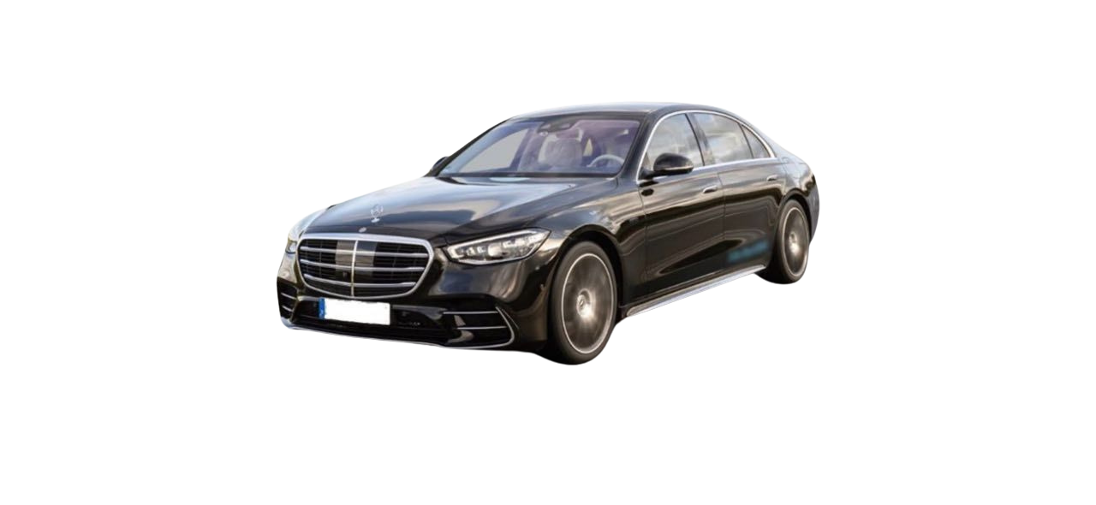
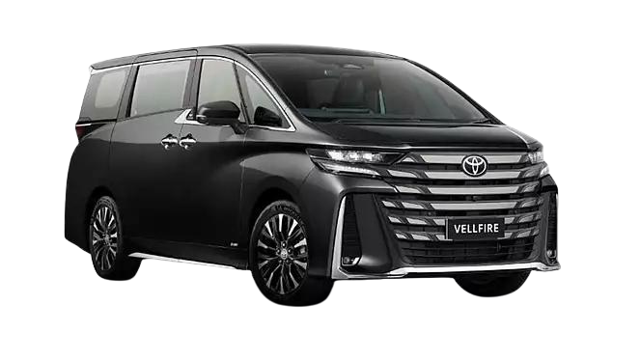

DRIVE TOWARDS YOUR DREAMS:
Top sales are entitled for:
Stand a Chance to Win Luxury Cars! Win the latest models of:
  Mercedes-Benz S-Class -Worth RM 698,744
  Toyota Vellfire – Worth RM 438,000
  BMW 5 Series – Worth RM 359,700
Yearly essentials minimum spending of RM1.4m to qualify.
Drive home your dream car – Enter now!

Slide 24

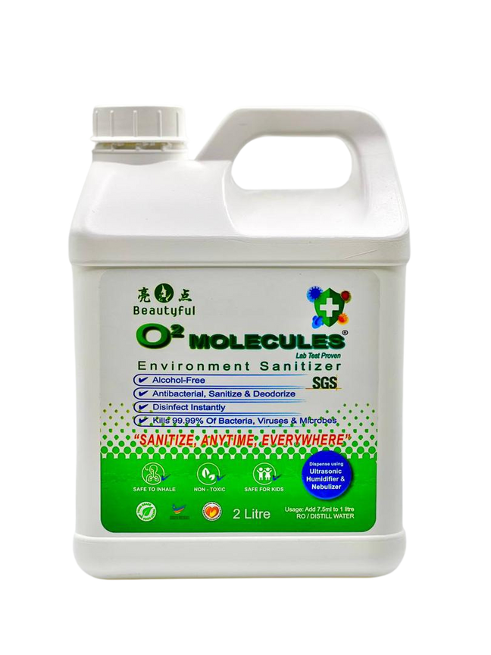

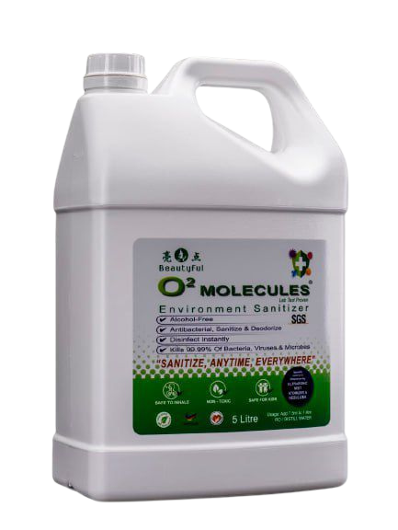
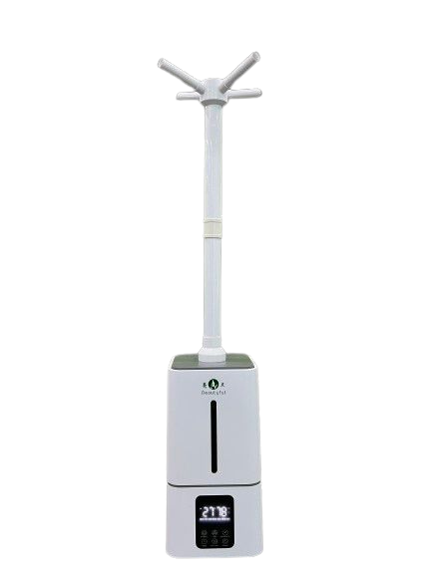
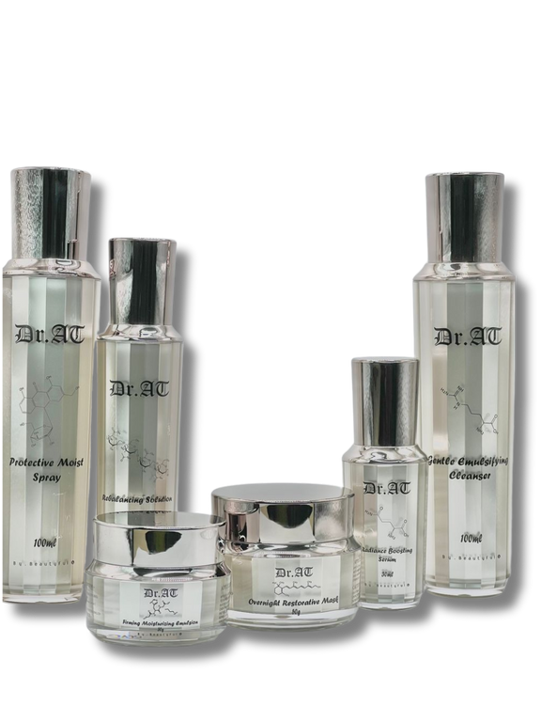
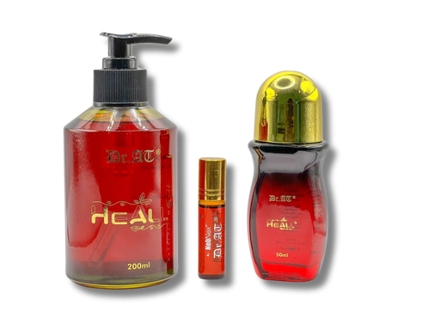
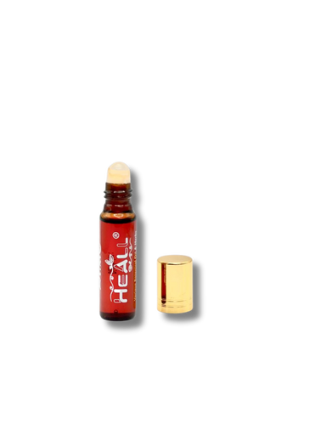
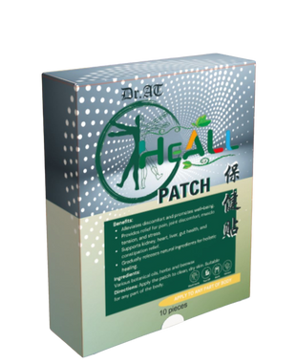
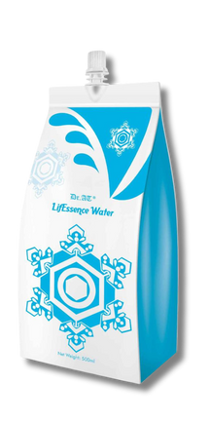
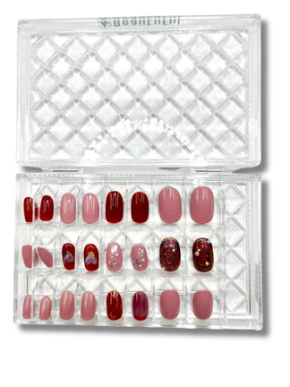
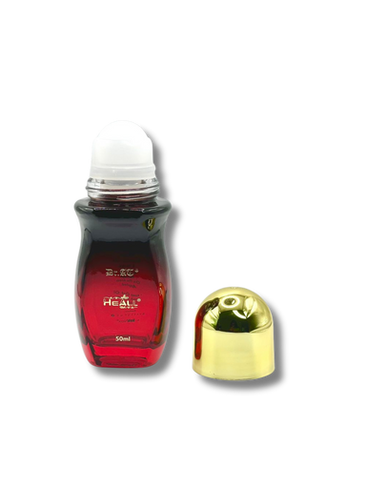

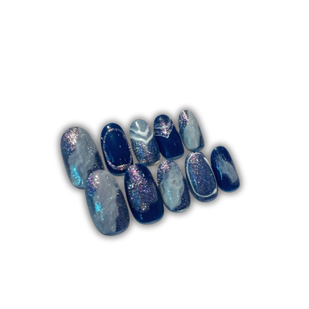
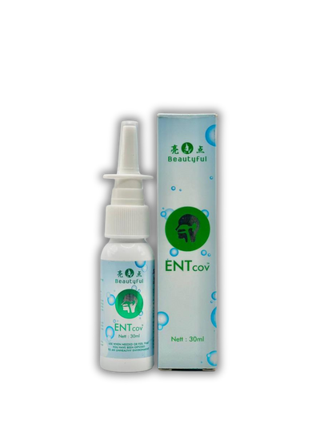
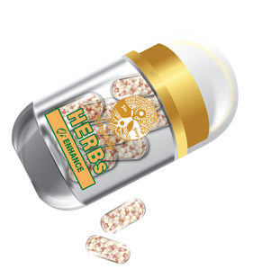
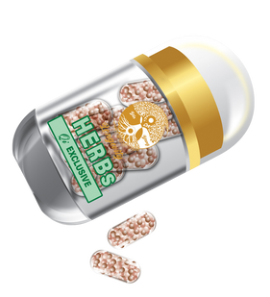


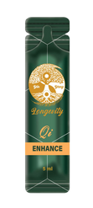
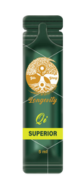
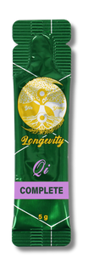
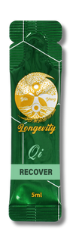
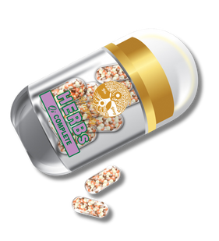
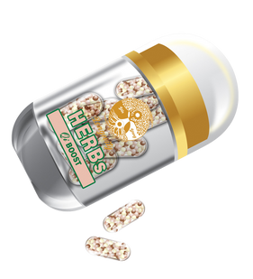
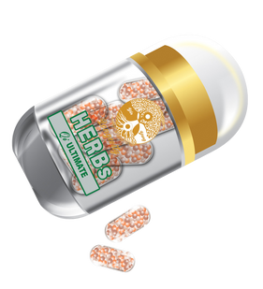

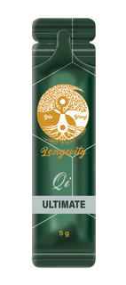


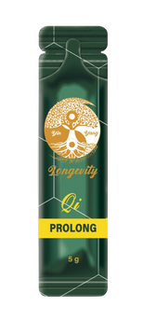
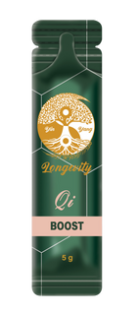
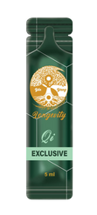
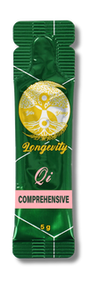
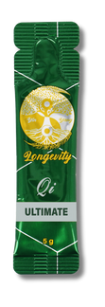
ESSENTIAL PRODUCTS SELECTION:
Delve into our diverse selection of 42 essential products meticulously crafted to elevate your journey towards graceful health and beauty.
Essential Necessities for Your Wellbeing

Slide 25



Limited Membership Opportunity: Grab your chance —
CBS memberships are limited .
To qualify, you have to join our CBS team (Consumer, Business, Shareholders).

Slide 26

Ready to Join Our CBS TEAM
&
Enjoy a 1-Year Supply of DrAT LifEssence Water?

Slide 27

JOIN OUR
Unlock a 1-year supply of LifEssence Water (365 packs)- Worth RM 7,300! 💧✨
Join our Influencer CBS TEAM with a one-time investment of RM 2,000 and enjoy exclusive perks while staying hydrated and elevating your lifestyle. 🌿💎
Don’t miss this chance to refresh, influence, and thrive! 🚀
INFLUENCER TEAM:-

Slide 28

INFLUENCER TEAM:-
As an Influencer CBS TEAM member, you’ll enjoy:
✅ A 1-Year Supply of:
  365 packs of 500ml DrAT LifEssence Water – worth RM 7,300
*Redeemed weekly by you*
Top-Up Option for an additional RM 2,000, which includes:
✅ An exclusive bundle worth RM2,000 in essential products
✅ Receive RM2000 worth of discount vouchers at a 25% off on any product
✅RM 2,000 credited to your account after you have used up your coupons
✅10% discount on future purchases
*One promotion per purchase*

Slide 29


INFLUENCER TEAM:-
Additional perks include:
✅Eligibility for Monthly Overseas Trips with a RM 100,000 monthly sales target
✅Exciting car prizes for top performers
*Term & Conditions Apply*
💎 Invest RM 4,000 → Receive RM 11,800 in Value!

Slide 30

Referral Rewards:
  If you refer 3 friends to join, we will refund your RM 2,000 investment in cash!
  If you refer another 4 friends, you’ll receive an additional RM 2,000 cashback, and your friends will be entitled to the same benefits as you.
  10% cashback on every expense made by your referrals!
INFLUENCER TEAM:-

Slide 31




UNLOCK EXCLUSIVE BENEFITS WITH
ECHELON CBS TEAM
To Enjoy more Perks
Join our ECHELON CBS TEAM with a one-time investment of RM 10,000 and unlock exclusive rewards!
ECHELON
CBS
SUPREME
IMPERIAL
Invest RM 10,000 → Receive RM30,720 in Value!

Slide 32
ECHELON CBS TEAM
Here’s what you’ll receive:
✅ A 1-Year Supply of:
  365 packs of 500ml DrAT LifEssence Water – worth RM 7,300
  80 bottles of 8ml DrAT Heall Oil – worth RM 920
*Redeemed weekly by you*
✅ An exclusive bundle worth RM 10,000 in essential products
✅ Receive RM10,000 worth of discount vouchers at a 25% off on any product
✅ RM 10,000 credited to your account after you have used up your coupons
✅ 20% discount on future purchases
*One promotion per purchase*

Slide 33
ECHELON CBS TEAM
Additional perks include:
✅Eligibility for Monthly Overseas Trips with a RM 100,000 monthly sales target
✅Year-End Share Bonus for qualified sales
✅Exciting car prizes for top performers
Take the first step toward exclusive rewards and success today!
*Term & Conditions Apply*

Slide 34



ELEVATE YOUR REWARDS WITH
SUPREME CBS TEAM
ECHELON
Upgrade to Supreme CBS Team by spending RM 20k and unlock unmatched rewards!
CBS
SUPREME
IMPERIAL
💎 Invest RM 20,000 → Receive RM 58,076 in Value!

Slide 35
Here’s what you’ll receive:
✅ A 1-Year Supply of:
  548 packs of 500ml DrAT LifEssence Water – worth RM 10,960
  184 bottles of 8ml DrAT Heall Oil – worth RM 2,116
*Redeemed weekly by you*
✅ An exclusive bundle worth RM 20,000 in essential products
✅Receive RM20,000 worth of discount vouchers at a 25% off on any product
✅RM 20,000 credited to your account after you have used up your coupon
✅30% discount on future purchases
*One promotion per purchase*
SUPREME CBS TEAM

Slide 36
SUPREME CBS TEAM
Additional perks include:
✅Eligibility for Monthly Overseas Trips with a RM 100,000 monthly sales target
✅Year-End Share Bonus for qualified sales
✅Exciting car prizes for top performers
Take the next step toward success and enjoy the exclusive rewards you deserve!
*Term & Conditions Apply*

Slide 37


EXPERIENCE LUXURY WITH
IMPERIAL CBS TEAM
Unlock the Ultimate Rewards with the Imperial CBS Team!
Join with an investment of RM 30,000 and gain access to these exclusive benefits:
ECHELON
CBS
SUPREME
IMPERIAL
🔥 Invest RM 30,000 → Receive RM 86,309 in Value!

Slide 38
Here’s what you’ll receive:
✅ A 1-Year Supply of:
  730 packs of 500ml DrAT LifEssence Water – worth RM 14,600
  366 bottles of 8ml DrAT Heall Oil – worth RM 4,209
*Redeemed weekly by you*
✅ An exclusive bundle worth RM 30,000 in essential products
✅ Receive RM30,000 worth of discount vouchers at a 25% off on any product
✅RM 30,000 credited to your account after you have used up your coupons
✅40% discount on future purchases
*One promotion per purchase*
IMPERIAL CBS TEAM

Slide 39
IMPERIAL CBS TEAM
Additional perks include:
✅Eligibility for Monthly Overseas Trips with a RM 100,000 monthly sales target
✅Year-End Share Bonus for qualified sales
✅Exciting car prizes for top performers
Elevate your lifestyle and experience unmatched rewards today!
*Term & Conditions Apply*

Slide 40

UNLOCK YEARLY BONUSES:
Join our exclusive program and unlock the opportunity for yearly bonuses! Here's how it works:
ELEVATE YOUR SALES PERFORMANCE
  CBS Entrepreneurs with consistent sales of RM100,000 monthly for 12 consecutive months within a year are eligible for a share of the 20% company’s net profit.
  The percentage of the bonus sharing among qualified CBS Entrepreneurs is calculated based on each CBS’s sales volume in relation to the company’s overall net profits.

Slide 41




DRIVE TOWARDS SUCCESS:
WIN EXCITING CAR PRIZES!
Achieve top sales by exceeding RM 1.4 million in personal sales, and be rewarded with a luxurious Mercedes-Benz S-Class
MERCEDES-BENZ S-CLASS
Drive your success to the next level! 🚗💎
Car Value: RM 698,744.

Slide 42

DRIVE TOWARDS SUCCESS:
WIN EXCITING CAR PRIZES!
Unlock the thrill of driving a Toyota Vellfire when your personal sales soar past RM 600,000 – RM 800,000. This luxury ride awaits you—turn your success into a powerful reward! 🚗
Vellfire
Car Value: RM 438,000

Slide 43

DRIVE TOWARDS SUCCESS:
WIN EXCITING CAR PRIZES!
Elevate your journey with a sleek BMW 5 Series by surpassing RM 400,000 – RM 600,000 in personal sales. This premium ride is your key to success—drive your ambition forward! 🚗✨
BMW 5 SERIES
Car Value: RM 359,700

Slide 44

UNLOCK YOUR BUSINESS POTENTIAL WITH
BEAUTYFUL APPS SYSTEM
Empower your business with our advanced BEAUTYFUL Apps system! Partners who aspire to expand their network, can leverage our existing BEAUTYFUL Apps. Seamlessly manage and grow your business with our user-friendly platform. Take control of your success and unlock new opportunities with innovation at your fingertips!

Slide 45

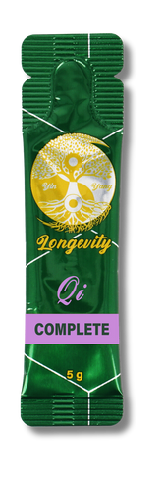
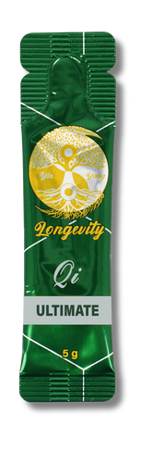
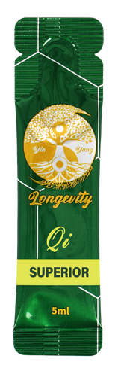
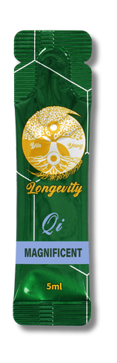
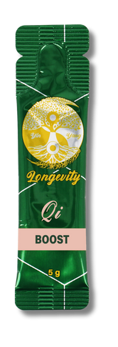
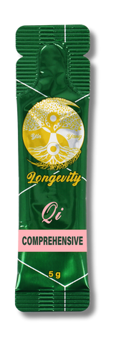

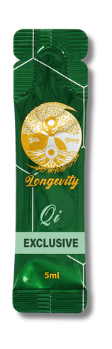
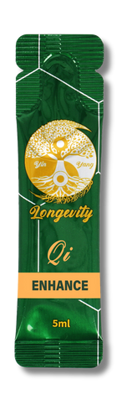
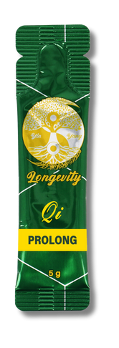

OUR PRODUCTS:-
Delve into our diverse selection of 42 essential products meticulously crafted to elevate your journey towards graceful health and beauty.
YIN YANG LONGEVITY QI HEALTH BEVERAGE
Work
Welcome to YIN YANG LONGEVITY QI HEALTH BEVERAGE. is our brand and for branding purposes. It is formulated and manufactured by Nebnex. Inspired by the wisdom "LET FOOD BE THY MEDICINE," our ten meticulously crafted variants nourish and revitalize your body. Unlock your body's hidden capabilities with our elixir, blending holistic principles and modern insights. Embrace vitality, health, and a transformative journey towards a healthier you with YIN YANG LONGEVITY QI HEALTH BEVERAGE.
Social

Slide 46
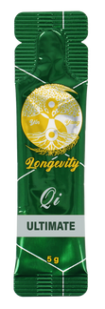
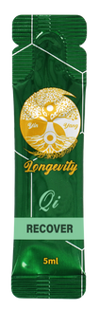
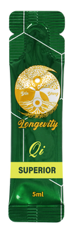
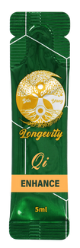
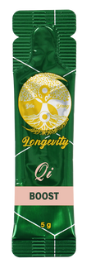





OUR PRODUCTS:-
Delve into our diverse selection of 42 essential products meticulously crafted to elevate your journey towards graceful health and beauty.
YIN YANG LONGEVITY QI HEALTH BEVERAGE VARIANTS:
QI ULTIMATE
Immune Support & Vitality: Enhances immunity, supports energy production, cardiovascular health, and reduces inflammation for long-term wellness.
QI RECOVER
Cellular & Heart Health: Supports mitochondrial function, immune defense, bone health, and cardiovascular balance.
QI ENHANCE
Skin & Bone Vitality: Boosts bone strength, skin elasticity, protein synthesis, and inflammation management.
QI SUPERIOR
Bone & Skin Health: Promotes strong bones, collagen formation for skin, joint support, cellular repair, and immune defense.
QI BOOST
Detox & Cellular Resilience: Aids detoxification, boosts cellular defense, supports gut health, metabolism, and inflammation management.
QI COMPREHENSIVE
Detox & Weight Balance: Facilitates detox, supports weight management, cellular energy, immune health, and enzyme functions.
QI EXCLUSIVE
Joint & Energy Metabolism: Supports joint mobility, cellular energy, and anti-aging, enhancing muscle recovery and NAD+ levels.
QI MAGNIFICENT
Cognitive & Metabolic Support: Enhances cognitive function, glucose metabolism, reduces inflammation, and provides antioxidant support.
QI PROLONG
Vitality & Bone Health: Promotes sustained energy, muscle support, bone density, and overall metabolic function.
QI COMPLETE
Joint & Muscle Strength: Enhances joint and muscle health, supports enzyme reactions, and aids in healthy aging.

Slide 47









OUR PRODUCTS:-
Delve into our diverse selection of 42 essential products meticulously crafted to elevate your journey towards graceful health and beauty.
YIN YANG LONGEVITY QI HERBs
Welcome to YIN YANG LONGEVITY QI HERBs, is our brand and for branding purposes. It is formulated and manufactured by Nebnex. Inspired by the ancient wisdom, "LET FOOD BE THY MEDICINE," our ten variants are carefully crafted to nourish and revitalize your body from within. Embark on a transformative journey with personalized insights and expert guidance on fibers, intermittent fasting, and chlorogenic acid. Our herbal blends harness the healing power of nature, promoting overall well-being and supporting your body's innate healing abilities. Embrace the synergy of tradition and science for a healthier you.

Slide 48



OUR PRODUCTS:-
Delve into our diverse selection of 42 essential products meticulously crafted to elevate your journey towards graceful health and beauty.
YIN YANG LONGEVITY QI HERBs VARIANTS:
QI ULTIMATE
Enhances cardiovascular health, manages lipids, reduces health risks, combats inflammation, supports microbial balance, and promotes overall well-being.
QI RECOVER
Supports cellular protection, metabolic health, inflammation management, immune support, kidney function, gastric wellness, and thyroid function for overall well-being.
QI SUPERIOR
Eases joint discomfort, supports liver health, aids weight management, enhances cardiovascular health, promotes genitourinary and digestive well-being, and harnesses nature's finest ingredients for overall vitality.
QI ENHANCE
Supports hormonal balance, cellular health, immune function, inflammation relief, microbial defense, weight management, and kidney well-being.
QI COMPREHENSIVE
Relief from menopausal symptoms, metabolic health management, cellular health promotion, microbial and viral defense, mood balance, and oxidative stress protection.
QI BOOST
Supports cellular vitality, oral health, and cardiovascular well-being while reducing inflammation and combating free radicals.
QI MAGNIFICENT
Enhance metabolic health, hormonal balance, microbial and viral defense, gastrointestinal comfort, blood clotting support, parasitic infection protection, and kidney health for holistic well-being and vitality.
QI EXCLUSIVE
Supports healthy aging, cognitive function, weight management, metabolic health, liver function, digestive wellness, and offers natural bacterial defense.
QI COMPLETE
Supports liver health, cellular vitality, age-related wellness, prostate health, lipid regulation, joint health, immune function, cardiovascular well-being, cellular maintenance, weight management, and glucose metabolism.
QI PROLONG
Enhances brain health, mitochondrial function, and physical fitness while providing cellular protection, supporting gastrointestinal health, and balancing inflammation.

Slide 49






OUR PRODUCTS:-
Delve into our diverse selection of 42 essential products meticulously crafted to elevate your journey towards graceful health and beauty.
Skincare:
A curated collection of six essential skincare products for a complete routine
Gentle Emulsifying Cleanser, 100ml-Nourishes while removing makeup.
REBALANCING SOLUTION, 50ml- Balances moisture and enhances radiance.
Protective Moist Spray, 100ml- Deep hydration with a pore-reducing mist.
Firming Moisturizing Emulsion 50ml- Firms, hydrates, and fights aging signs.
Radiance Boosting Serum, 50ml-
Multi-vitamin boost for collagen support
Overnight Restorative Mask, 100ml- Revitalizes your skin by morning for a fresh look.

Slide 50




Delve into our diverse selection of 42 essential products meticulously crafted to elevate your journey towards graceful health and beauty.
OUR PRODUCTS:-
DrAT HEALL RUB 7ml
RUB OIL & PATCHES
DrAT HEALL RUB 50ml
Introducing Heall Rub Oil, a breakthrough product by Nebnex Company under the DrAT brand, crafted with innovation and quality in mind. Heall Rub Oil provides fast and effective relief for vein and circulatory artery discomfort, muscle soreness, internal organ distress, and general aches. Made from natural ingredients, this powerful formulation reduces inflammation, improves circulation, and promotes healing, offering comprehensive pain relief. Available in 7ml, 50ml (rub), 200ml (oil) sizes, and patch form, Heall Rub Oil is your go-to solution for natural, effective pain management and skin health.
DrAT HEALL oil 200ml
DrAT HEALL PATCHES

Slide 51









Delve into our diverse selection of 42 essential products meticulously crafted to elevate your journey towards graceful health and beauty.
OUR PRODUCTS:-
BEAUTYFUL Plug & Wear fingernails

Slide 52

Delve into our diverse selection of 42 essential products meticulously crafted to elevate your journey towards graceful health and beauty.
OUR PRODUCTS:-
BEAUTYFUL ENTcov-ENT Cleanser-30ml
CLEANSING SPRAY
ENTcov Cleansing Spray is expertly formulated to act as a protective barrier against viruses, targeting entry points through the ear, nose, and throat. Enriched with deionized water and advanced oxygenated water technology, this spray offers a cutting-edge solution for safeguarding your respiratory health. Stay ahead of potential threats and enhance your well-being with ENTcov Cleansing Spray.

Slide 53



Dr.AT
Delve into our diverse selection of 42 essential products meticulously crafted to elevate your journey towards graceful health and beauty.
OUR PRODUCTS:-
BEAUTYFUL O2 Molecules Environment Sanitizer-2liters
BEAUTYFUL
  Achieve a cleaner and healthier atmosphere with the world's first food-grade O₂ Molecule Sanitizer, dispensed through our advanced Mist Atomizer.
  This revolutionary sanitizer provides 99.99% germ protection while hydrating the skin—safe for all ages and effective over an area of up to 1,000 sq. ft.
BEAUTYFUL O2 Molecules Environment Sanitizer-5liters
Mist atomizer

Slide 54




Delve into our diverse selection of 42 essential products meticulously crafted to elevate your journey towards graceful health and beauty.
OUR PRODUCTS:-
Pure Hydration: Supports hydration, electrolyte balance, healthy digestion, and helps lower blood pressure.
Empower Your Wellness: Enhances immune response, promotes libido, and supports urinary health.
INTIMACY
S
b
Sports Nutrition Meal Replacement Gummy: A nutritious gummy snack designed to support weight management, appetite control, and digestion.
lim
ST
Cell Activation Support: This innovative patch delivers active compounds to acupuncture points, activating senescent cells and promoting overall health and vitality.
S-CellAct

Slide 55




Delve into our diverse selection of 42 essential products meticulously crafted to elevate your journey towards graceful health and beauty.
OUR PRODUCTS:-
ureLife
Natural Health Blend: A potent natural blend in drop form that supports stress relief, enhances cognitive clarity, and boosts physical vitality.
Revitalize Your Hair: Nourish the scalp and promote healthy hair growth with our revolutionary formula.
olli
ure

Slide 56
Delve into our diverse selection of 42 essential products meticulously crafted to elevate your journey towards graceful health and beauty.
OUR PRODUCTS:-
‘CLEANSE’:(Detox)
SleepAid
SOBER’ (SPRAY/ODF)
SnowWhite Skin brightening Cream
SkinPeel Mask Change Face Look

Slide 57




Join Us
016-873 2331
+603 9080 6336
support@nebnex.com
www.nebnex.com
Lot 58546 Jalan CJ1/1,Kawasan Perindustrian Cheras Jaya,
43200 Balakong, Selangor, Malaysia.
  Don't miss out on this exclusive opportunity to create a healthier and wealthier you, gracefully.
  Contact us to learn more and become a CBS TEAM today.

